Slide 1





Machine Learning (Reinforcement Learning)

Slide 2
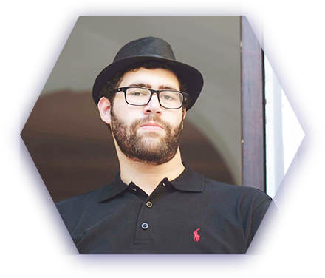
Hello!
I am Eslam Ahmed
I am a software engineer.
You can find me at jeksogsa@gmail.com

Slide 3

Hello!
I am Eman Ehab
I am a ML research engineer.
You can find me at emanehab.ieee@gmail.com

Slide 4



Contents
What is Machine Learning.
What is Reinforcement Learning.
Applications of Reinforcement Learning.
Why RL is Freaky.
Markov Decision Process (MDP).
MDP Examples.
MDP Solution.
Q-Learning Algorithm.
Open AI Gym environment.
Coding time >_

Slide 5
Contents
What is Machine Learning.
What is Reinforcement Learning.
Applications of Reinforcement Learning.
Why RL is Freaky.
Markov Decision Process (MDP).
MDP Examples.
MDP Solution.
Q-Learning Algorithm.
Open AI Gym environment.
Coding time >_

Slide 6
Machine Learning
Supervised learning : Task Driven (Classification)
Unsupervised learning : Data Driven (Clustering)
Reinforcement learning :
Close to human learning.
Algorithm learns a policy of how to act in a given environment.
Every action has some impact in the environment, and the environment provides rewards that guides the learning algorithm.

Slide 7
Contents
What is Machine Learning.
What is Reinforcement Learning.
Applications of Reinforcement Learning.
Why RL is Freaky.
Markov Decision Process (MDP).
MDP Examples.
MDP Solution.
Q-Learning Algorithm.
Open AI Gym environment.
Coding time >_

Slide 8
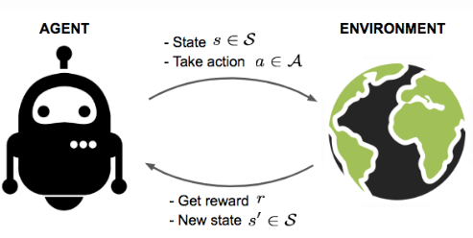
What is RL ?

Slide 9
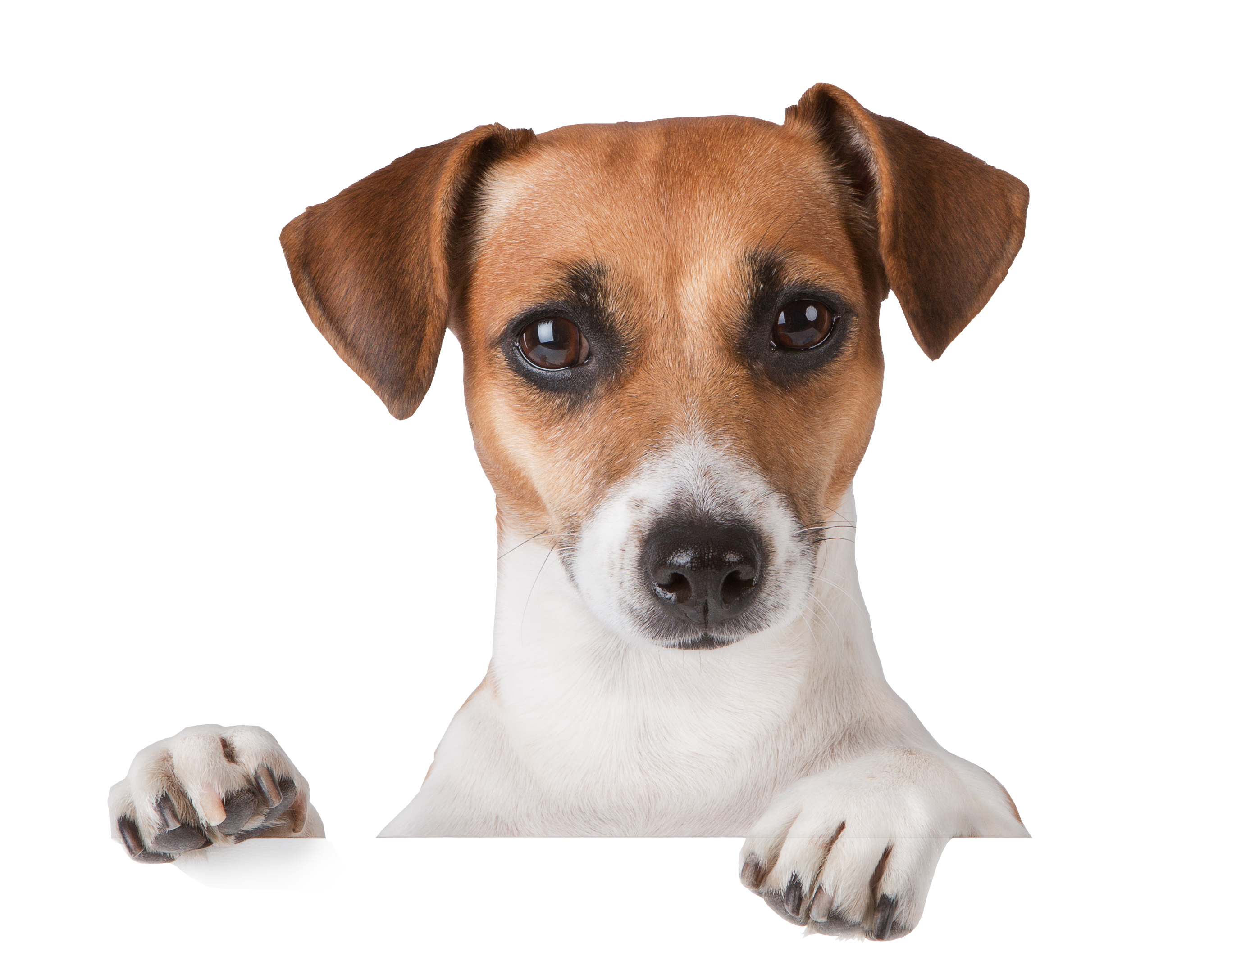
What is RL ?
3azooz (Agent)

Slide 10
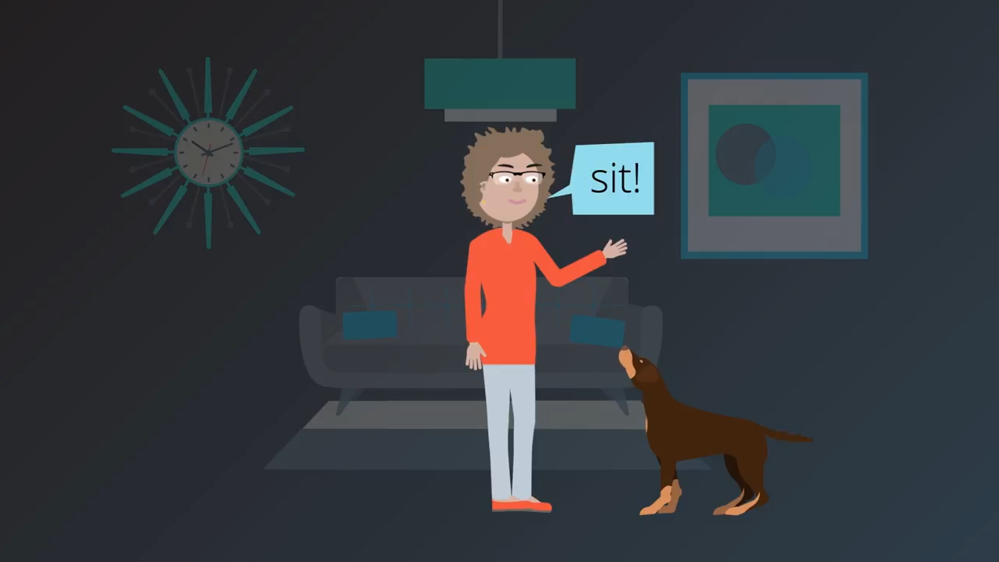
What is RL ?
Observe Environment

Slide 11
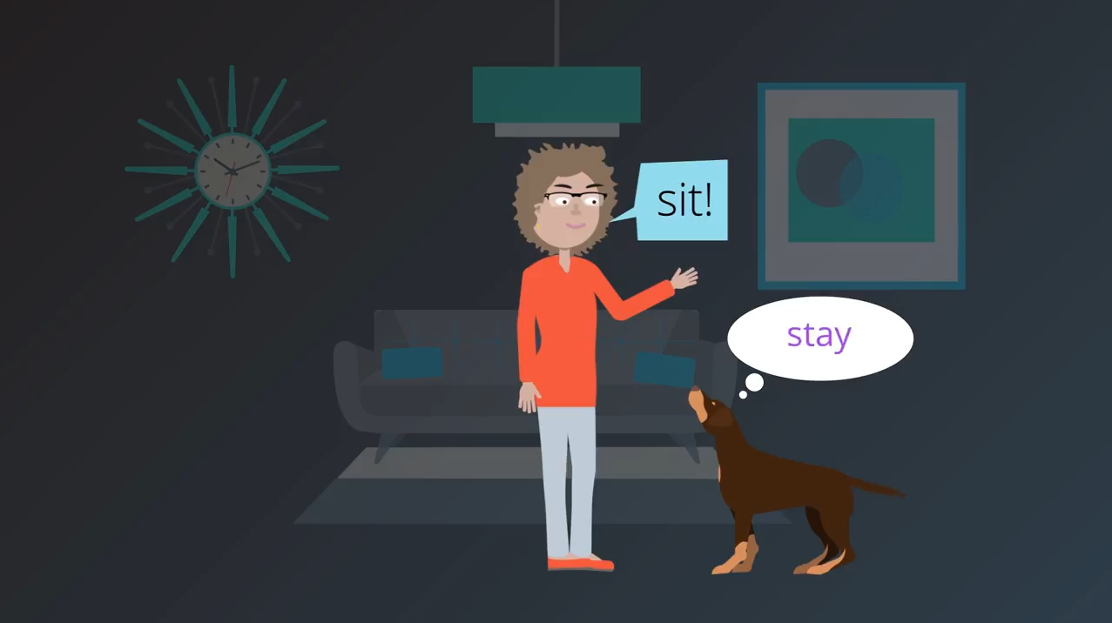
What is RL ?
Explore
Actions

Slide 12

What is RL ?
Explore
Actions

Slide 13

What is RL ?
Explore
Actions

Slide 14
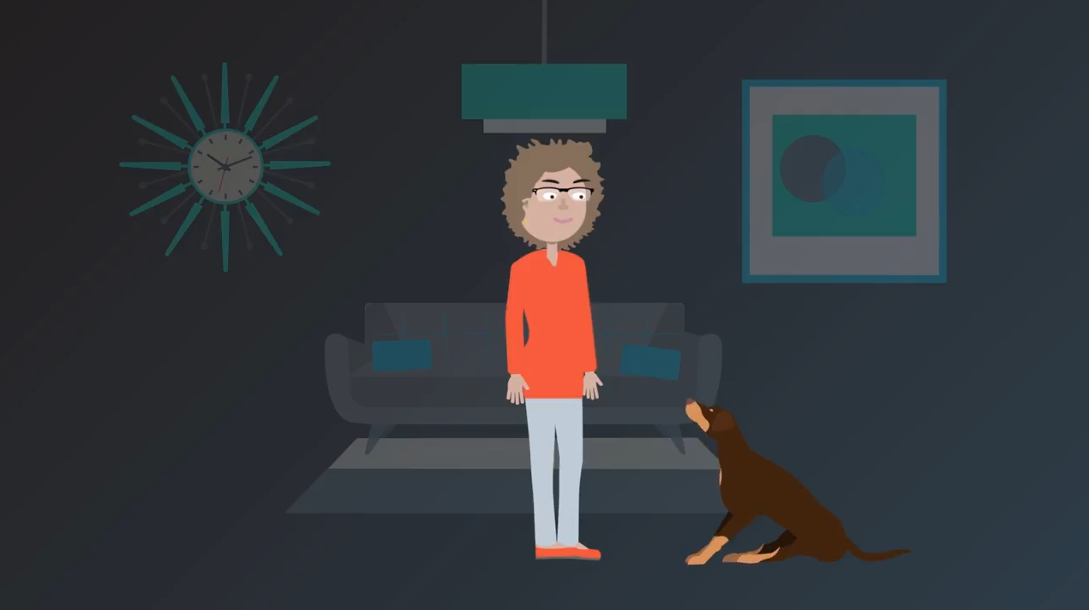
What is RL ?
Choose Random Action
(Sit)

Slide 15
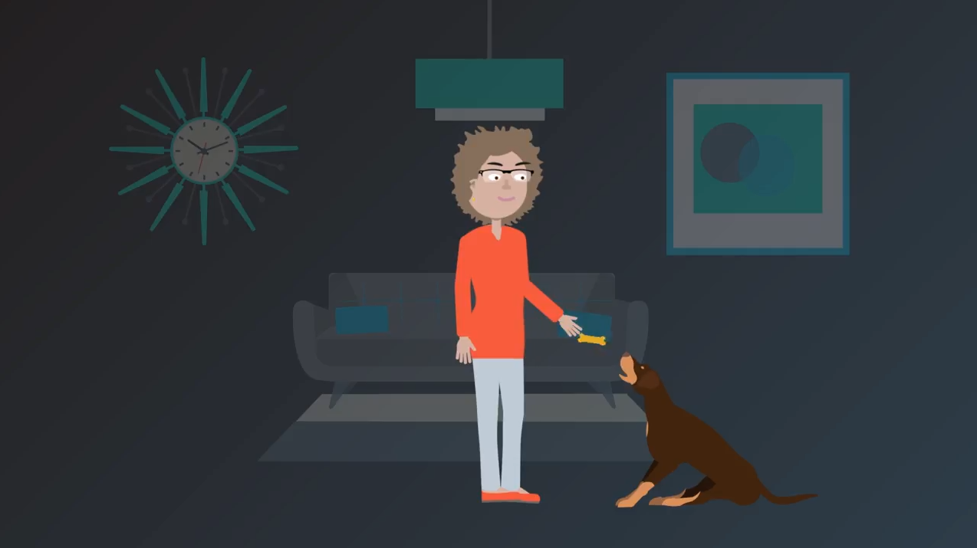
What is RL ?
Have a reward

Slide 16
What is RL ?
Ok that’s a good action

Slide 17
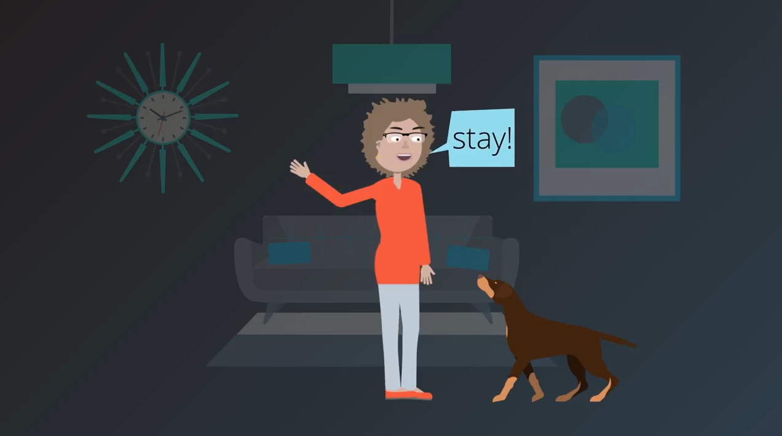
What is RL ?
Observe Environment

Slide 18

What is RL ?
Explore
Actions

Slide 19

What is RL ?
Explore
Actions

Slide 20

What is RL ?
Explore
Actions

Slide 21
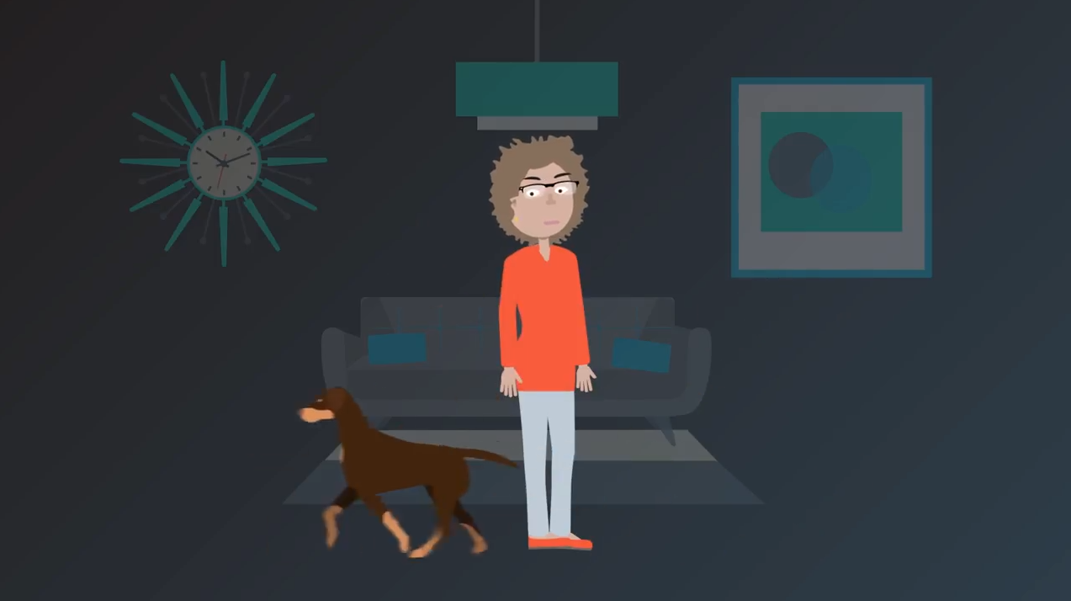
What is RL ?
Choose Random Action
(Run)

Slide 22
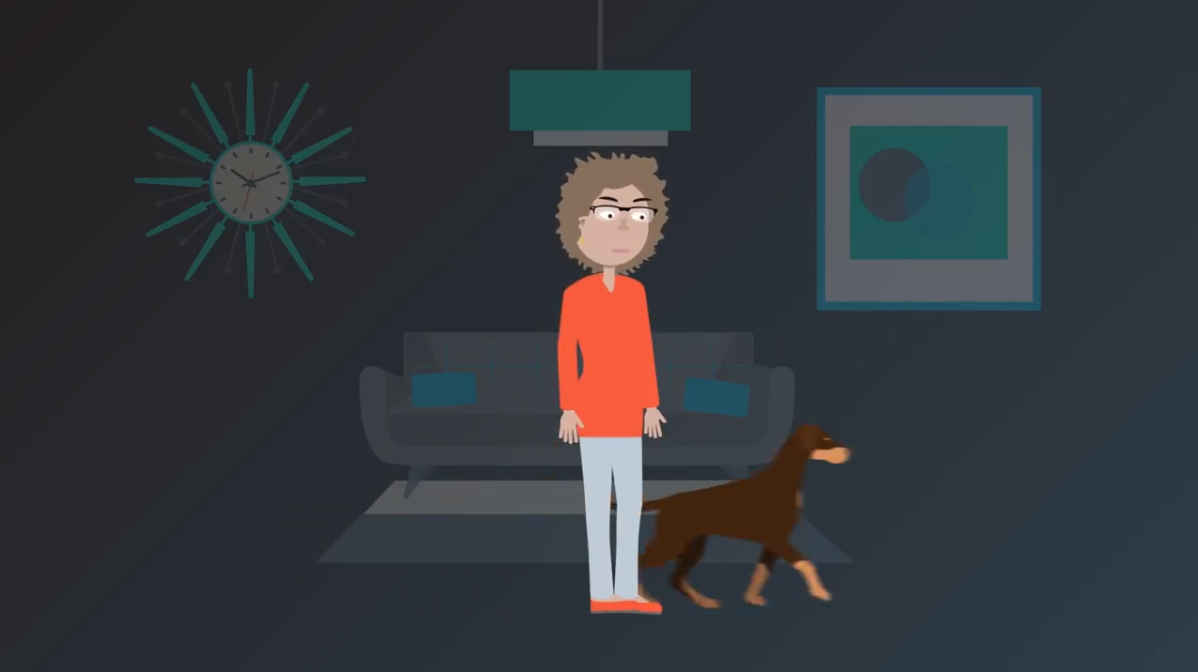
What is RL ?
Choose Random Action
(Run)

Slide 23
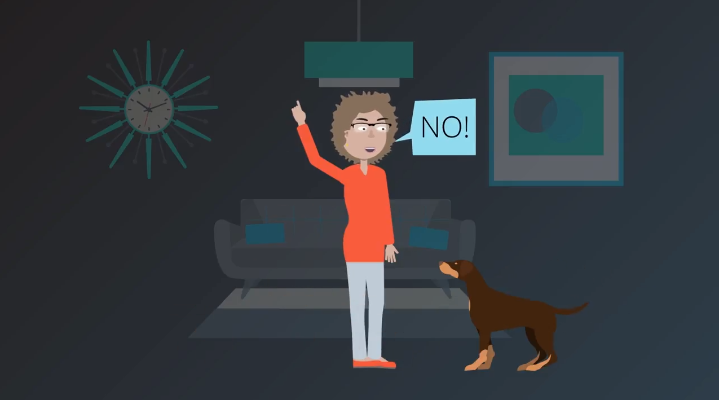
What is RL ?
Have a penalty

Slide 24
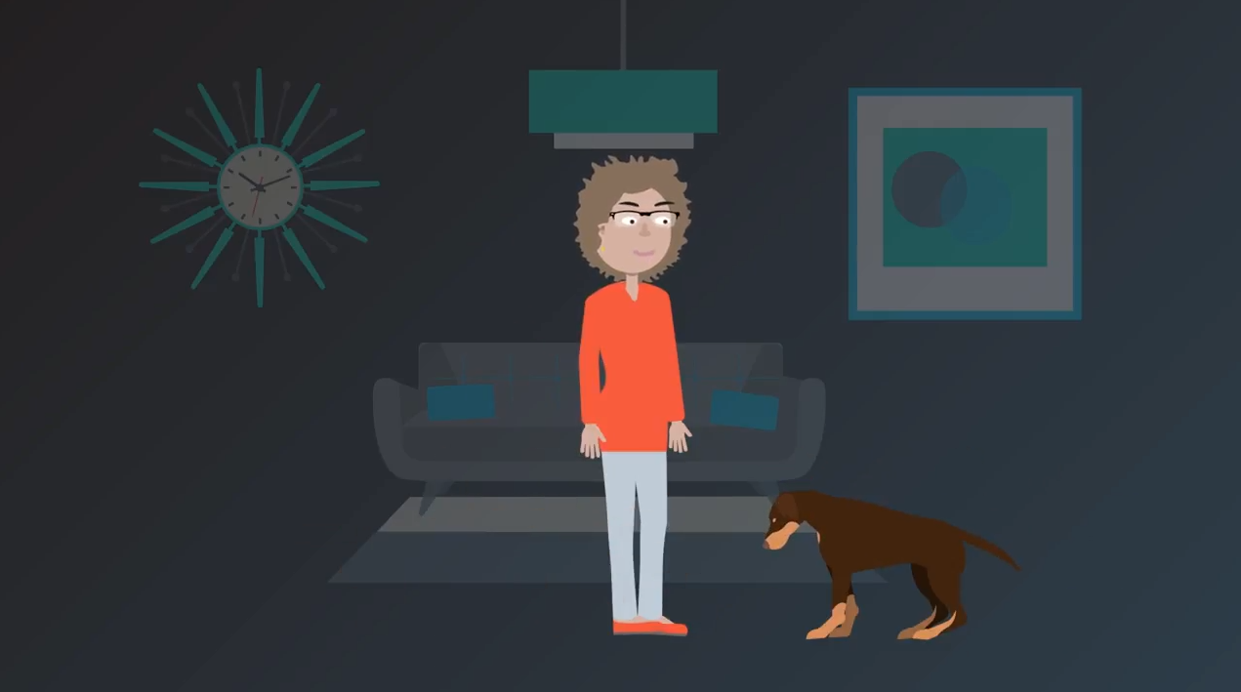
What is RL ?
Ok that’s a bad action

Slide 25
What is RL ?
Again and again for a lot of times (Episodes)

Slide 26
Contents
What is Machine Learning.
What is Reinforcement Learning.
Applications of Reinforcement Learning.
Why RL is Freaky.
Markov Decision Process (MDP).
MDP Examples.
MDP Solution.
Q-Learning Algorithm.
Open AI Gym environment.
Coding time >_

Slide 27
Reinforcement Learning Apps
Robotics.
Self Driving Cars.
Game Playing.
Finance.
…

Slide 28
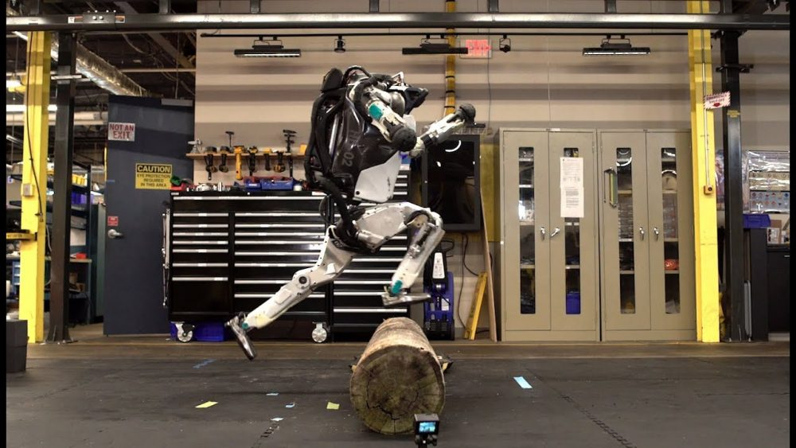
Reinforcement Learning Apps
Robotics.
Self Driving Cars.
Game Playing.
Finance.
…

Slide 29
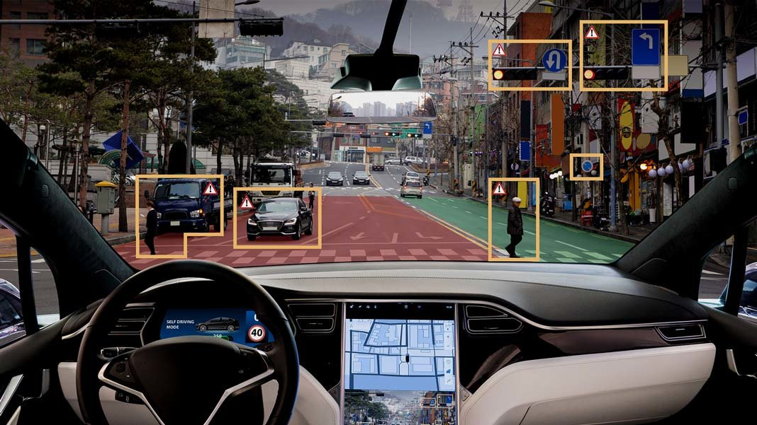
Reinforcement Learning Apps
Robotics.
Self Driving Cars.
Game Playing.
Finance.
…

Slide 30
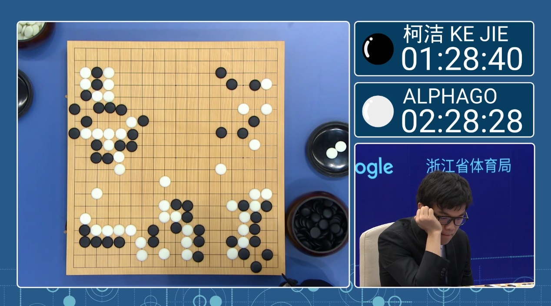
Reinforcement Learning Apps
Robotics.
Self Driving Cars.
Game Playing.
Finance.
…

Slide 31

Reinforcement Learning Apps
Robotics.
Self Driving Cars.
Game Playing.
Finance.
…

Slide 32
Contents
What is Machine Learning.
What is Reinforcement Learning.
Applications of Reinforcement Learning.
Why RL is Freaky.
Markov Decision Process (MDP).
MDP Examples.
MDP Solution.
Q-Learning Algorithm.
Open AI Gym environment.
Coding time >_

Slide 33
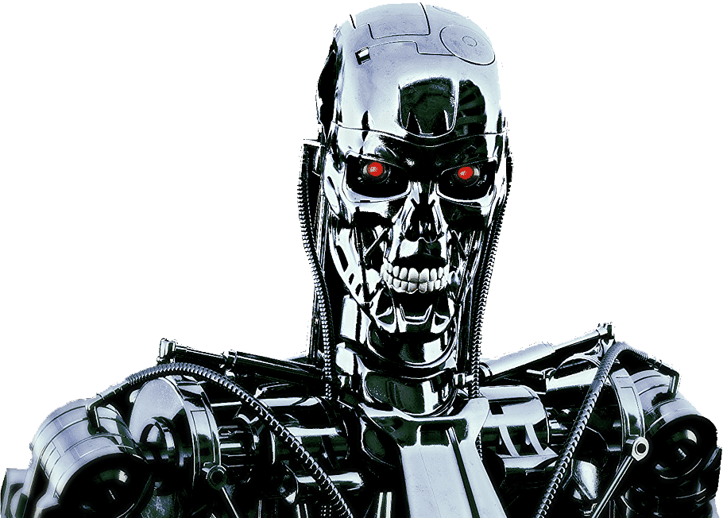
Why RL is Creepy ?

Slide 34
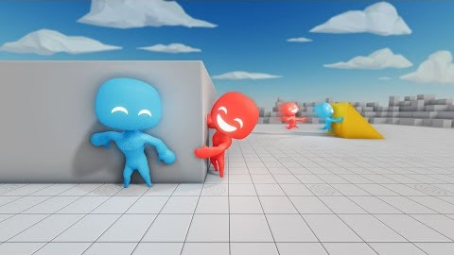
Why RL is Creepy ?

Slide 35
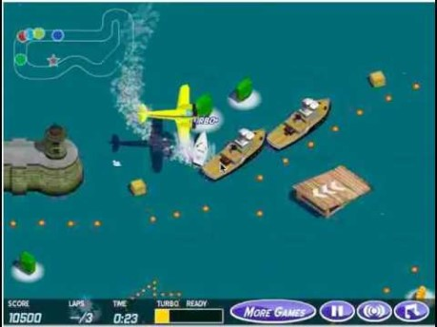
Why RL is Creepy ?

Slide 36
Contents
What is Machine Learning.
What is Reinforcement Learning.
Applications of Reinforcement Learning.
Why RL is Freaky.
Markov Decision Process (MDP).
MDP Examples.
MDP Solution.
Q-Learning Algorithm.
Open AI Gym environment.
Coding time >_

Slide 37
Markov Decision process (MDP)
Agent
Environment
Set of States [S]
Set of Actions [A]
Expected Rewards for taking an action in a state [R(s, a)]
Goal is to find the optimal action taken in any state to get the maximum rewards (Optimal Policy).

Slide 38
Contents
What is Machine Learning.
What is Reinforcement Learning.
Applications of Reinforcement Learning.
Why RL is Freaky.
Markov Decision Process (MDP).
MDP Examples.
MDP Solution.
Q-Learning Algorithm.
Open AI Gym environment.
Coding time >_

Slide 39
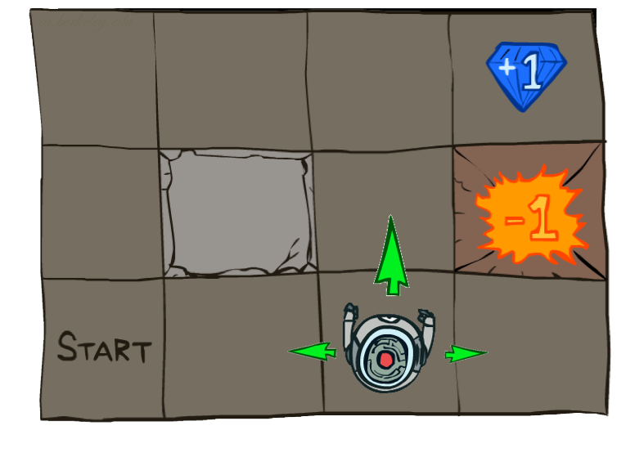
Markov Decision process (MDP) - Maze
Set of States
- Robot position in grid
Set of Actions
- Up, Down, Right, Left
Rewards
- (+1) if get the diamond.
- (-1) if go to the fire.
- …

Slide 40
Markov Decision process (MDP) - Robot
Set of States
- Camera and Sensors.
Set of Actions
- Torque on the joints to walk or jump.
Rewards
- (+10) if not fall while jumping.
- (-5) if apply high torque on joints.
- …

Slide 41
Markov Decision process (MDP) - Self driving car
Set of States
- Camera and Sensors.
Set of Actions
- Steer, Throttle, Break.
Rewards
- (-1000) if hit human.
- (-500) if hit a car.
- …

Slide 42
Contents
What is Machine Learning.
What is Reinforcement Learning.
Applications of Reinforcement Learning.
Why RL is Freaky.
Markov Decision Process (MDP).
MDP Examples.
MDP Solution.
Q-Learning Algorithm.
Open AI Gym environment.
Coding time >_

Slide 43
MDP Solution.
Policy.
Exploration vs Exploitation.
Reward Function.
Discounted Reward Factor.
Q-Values.

Slide 44
MDP Solution.
Policy.
Exploration vs Exploitation.
Reward Function.
Discounted Reward Factor.
Q-Values

Slide 45
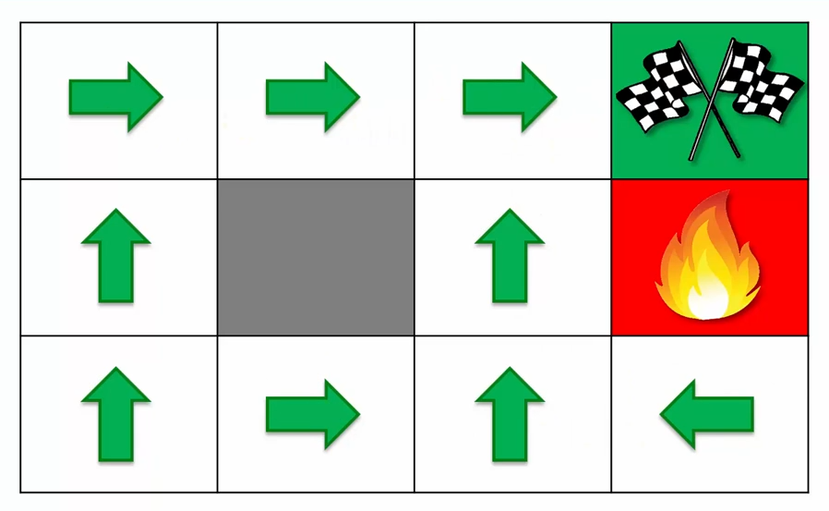
Policy
The set of actions for all the states that solves the MDP and get to the Goal.
The Optimal policy is the best actions led to the maximum reward for solving the goal.

Slide 46
MDP Solution.
Policy.
Exploration vs Exploitation.
Reward Function.
Discounted Reward Factor.
Q-Values

Slide 47
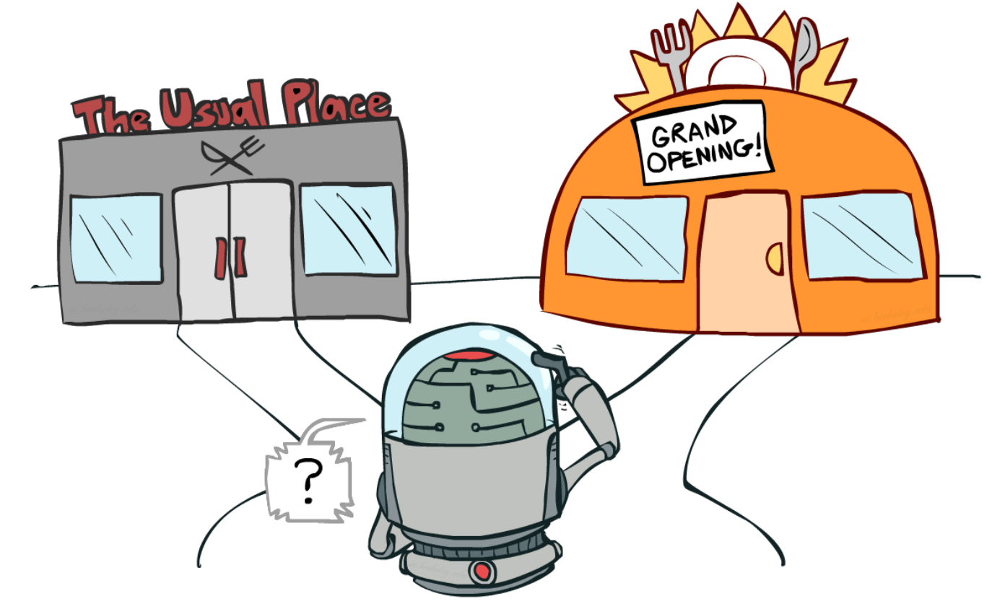
Exploration vs Exploitation
Exploration
Keep taking random actions to gain more knowledge about the environment.
Exploitation
Use your gained knowledge to take actions based on your collected experience.

Slide 48
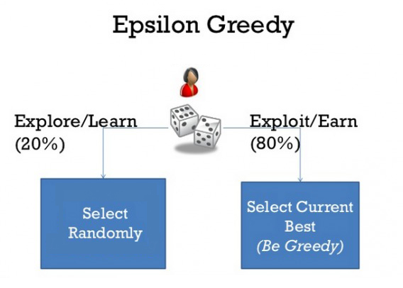
Exploration vs Exploitation
Epsilon = 0.2 (20%) having random action.
(1-Epsilon) = 0.8 (80%) the agent became greedy for having an action from collected experience.
(Epsilon-Greedy algorithm)

Slide 49
Exploration vs Exploitation
At first we set epsilon to 1 (100%) so at first the agent will explore the environment (taking random actions).
Then gradually decaying the epsilon value (start explore then gradually exploit while collecting knowledge).
At the end epsilon will be ~ 0 so that the agent now has a great knowledge about the environment and no need to take random actions any more.
(Epsilon-Greedy algorithm)

Slide 50
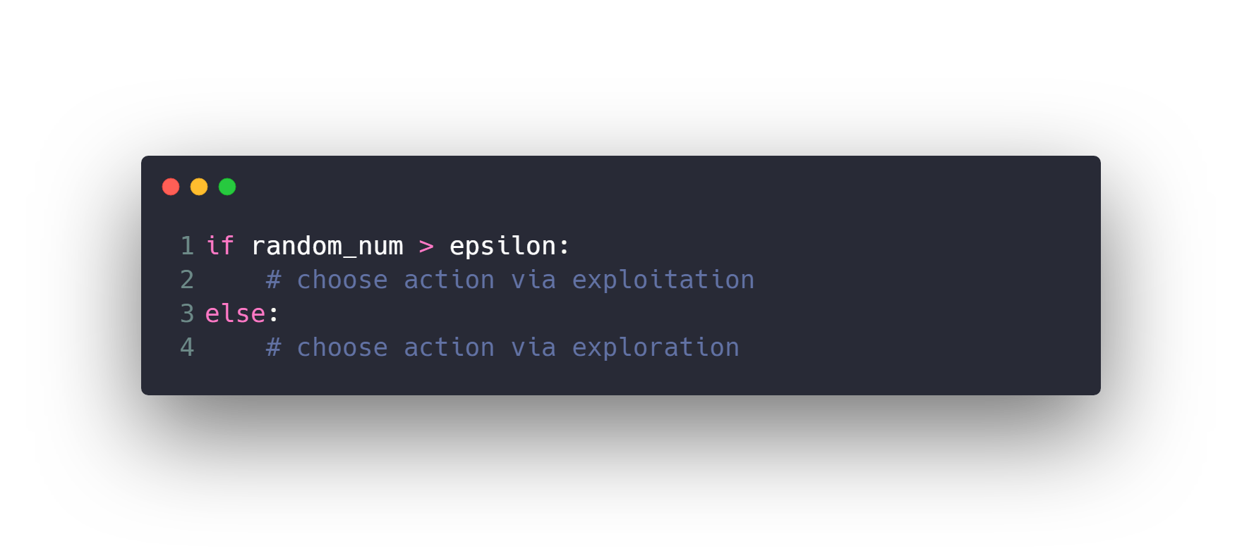
Exploration vs Exploitation
(Epsilon-Greedy algorithm)
Implementation
1- Generate a random number between 0 & 1.
2- If the number is > current epsilon value then exploit the knowledge.
3- If the number is < current epsilon value then explore random action.
4- Decay the epsilon over time.

Slide 51
MDP Solution
Policy.
Exploration vs Exploitation.
Reward Function.
Discounted Reward Factor.
Q-Values

Slide 52
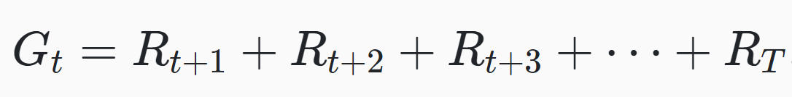
Reward Function
The goal of an agent in an MDP is to maximize its cumulative rewards. For this, we introduce the concept of the expected return of the rewards at a given time step.
The expected return of the rewards is what's driving the agent to make the decisions it makes.

Slide 53
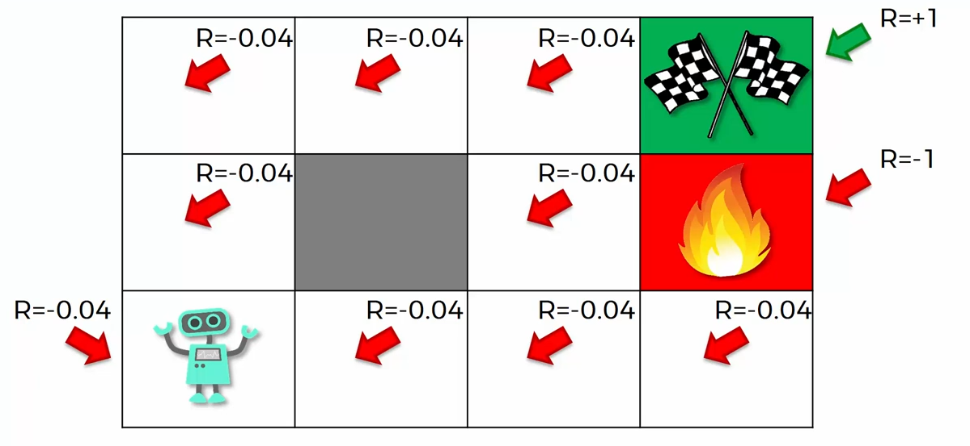
Reward Function

Slide 54
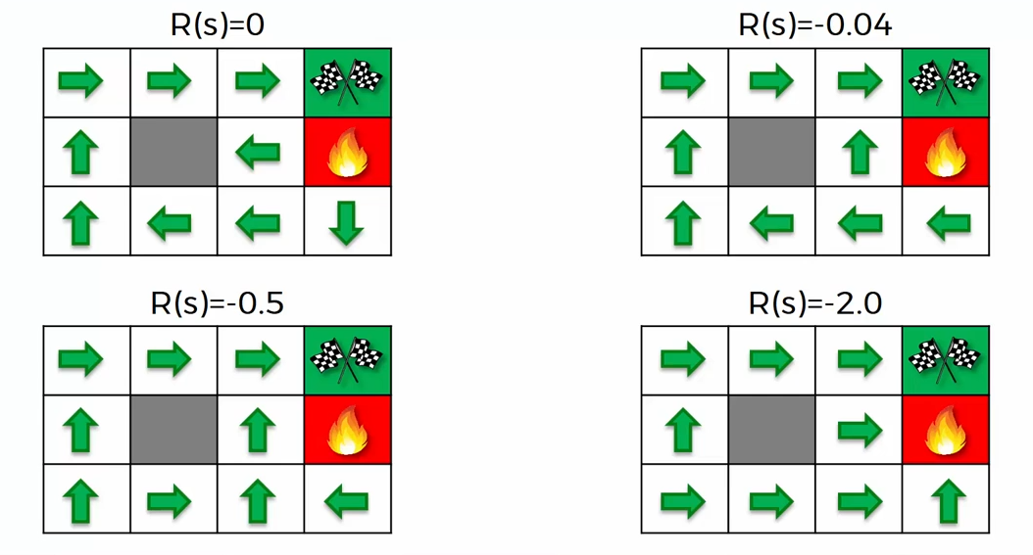
Reward Function

Slide 55
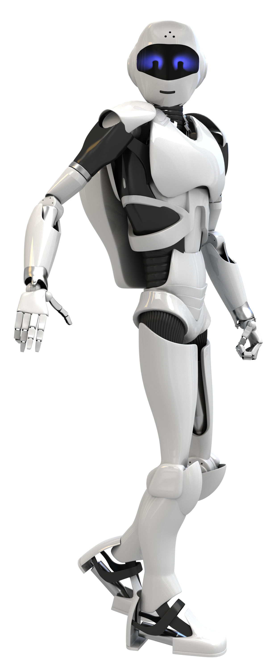
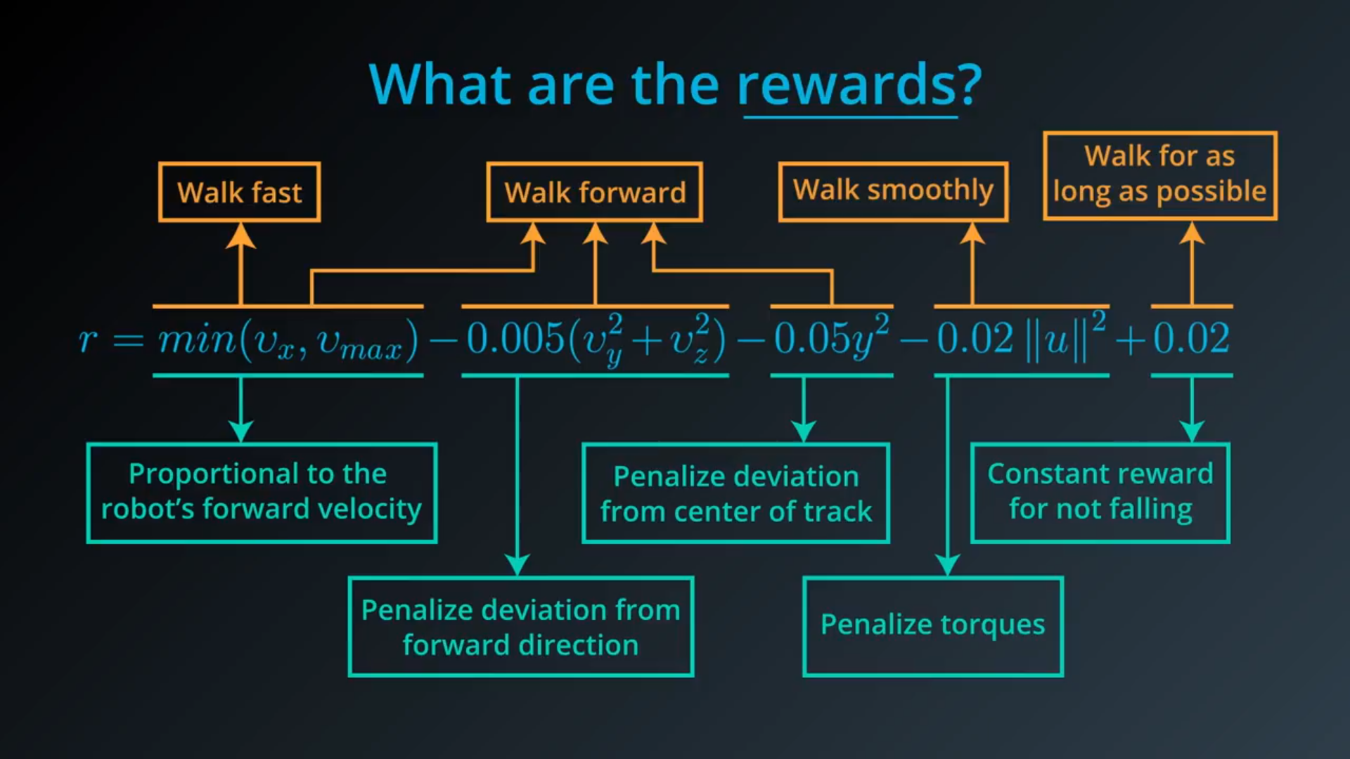
Reward Function

Slide 56
MDP Solution
Policy.
Exploration vs Exploitation.
Reward Function.
Discounted Reward Factor.
Q-Values

Slide 57
Discounted Reward Factor
Do you prefer to have one Million
Dollars now or tomorrow ?!

Slide 58
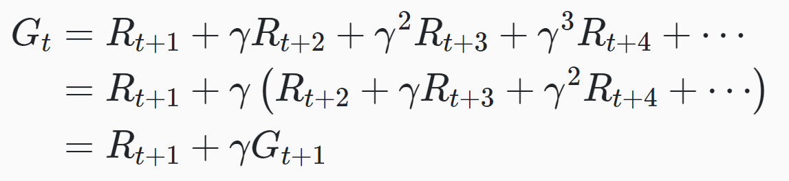
Discounted Reward Factor
For sure you will choose having the money now rather than tomorrow, because immediate rewards are the most valuable and more important than the next future rewards.
So to make the agent cares a lot of immediate rewards more than the future rewards, we added the discount factor (gamma = 0.9).

Slide 59
MDP Solution
Policy.
Exploration vs Exploitation.
Reward Function.
Discounted Reward Factor.
Q-Values

Slide 60
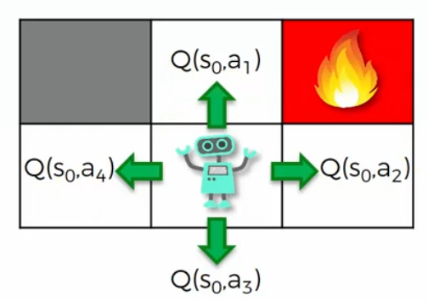
Q-Values
Q-Values for a state are the probabilities of taking an action between set of actions in a given state.
For example: in this state the robot have 4 actions (up, down, right, left) for this state, we make 4 q-values one for each action, the highest q-value for an action is the optimal action to take.

Slide 61
Contents
What is Machine Learning.
What is Reinforcement Learning.
Applications of Reinforcement Learning.
Why RL is Freaky.
Markov Decision Process (MDP).
MDP Examples.
MDP Solution.
Q-Learning Algorithm.
Open AI Gym environment.
Coding time >_

Slide 62
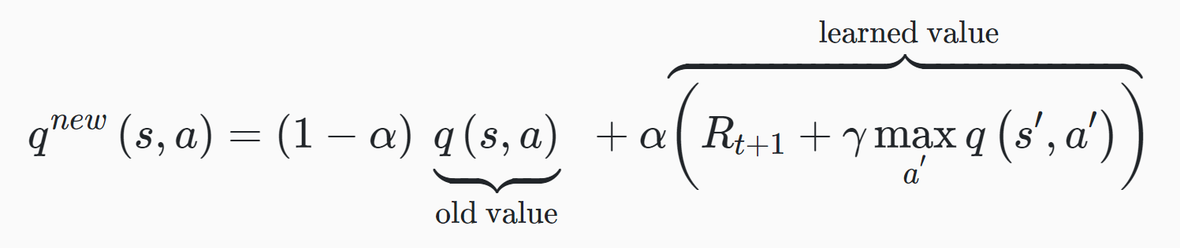
1. Initialize Q(s, a) by setting all of the Q-Values for each state equal to zero, epsilon = 1.
2. Observe the current state.
3. Based on the epsilon-greedy policy, choose an action (explore or exploit).
4. Take action A and observe the resulting reward, and
the new state of the environment S’.
5. Update Q(s, a) based on the update rule.
Where R[t+1] is the reward, alpha is the learning rate and gamma is the discount rate = 0.9,
Q(s’, a’) is the maximum q-value for an action at the next state.
6. S = S’ & Decay epsilon then Repeat steps 2–6 until convergence.
Q Learning Algorithm

Slide 63
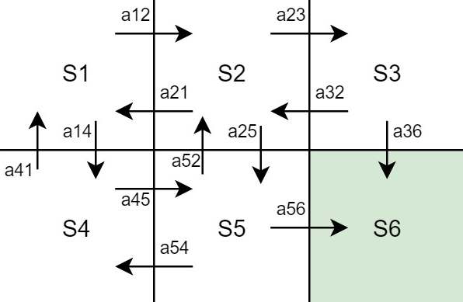
Q Learning Algorithm (Grid World)
Consider a grid world environment that a robot wants to reach the flag at state 6.

Slide 64
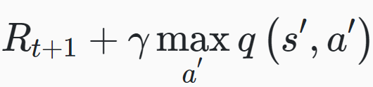
Q Learning Algorithm (Grid World)
Q(S, A) | Value
Q(S1, A12) | 0
Q(S1, A14) | 0
Q(S2, A21) | 0
Q(S2, A23) | 0
Q(S2, A25) | 0
Q(S3, A32) | 0
Q(S3, A36) | 0
Q(S4, A41) | 0
Q(S4, A45) | 0
Q(S5, A54) | 0
Q(S5, A52) | 0
Q(S5, A56) | 0
1. Initialize problem by this settings:
All of the Q-Values for each state equal to zero.
Epsilon = 1.
Gamma = 0.5.
Alpha = 1.
The flag reward is +100 at state S6 otherwise zero.
When alpha = 1 for simplicity, the equation became

Slide 65
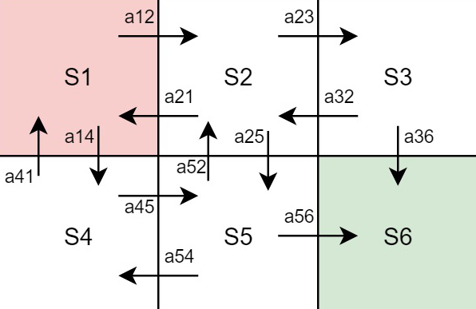
Q Learning Algorithm (Grid World)
2. Observe the current state S1 (the red state), available actions are (a12, a14) lets say we took action a12 so we became at state S’ = S2.
3. Calculate q_new(S1, a12) with the equation using q-values from the table.
q_new(S1, a12) = r + 0.5 * max[q(S2, a21), q(S2, a23), q(S2, a25)]
= 0 + 0.5 * 0 = 0

Slide 66
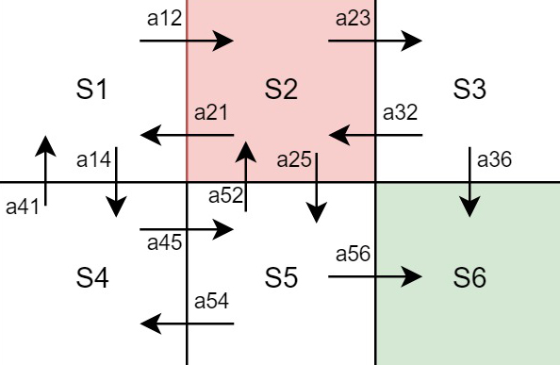
Q Learning Algorithm (Grid World)
Q(S, A) | Value
Q(S1, A12) | 0
Q(S1, A14) | 0
Q(S2, A21) | 0
Q(S2, A23) | 0
Q(S2, A25) | 0
Q(S3, A32) | 0
Q(S3, A36) | 0
Q(S4, A41) | 0
Q(S4, A45) | 0
Q(S5, A54) | 0
Q(S5, A52) | 0
Q(S5, A56) | 0
4- Update the q table with new Q(S1, A12) value = 0.
5- New State became S2.

Slide 67
Q Learning Algorithm (Grid World)
6. Observe the current state S2 (the red state), available actions are (a21, a23, a25) lets say we took action a23 so we became at state S’ = S3.
7. Calculate q_new(S2, a23) with the equation using q-values from the table.
q_new(S2, a23) = r + 0.5 * max[q(S3, a32), q(S3, a36)]
= 0 + 0.5 * 0 = 0

Slide 68
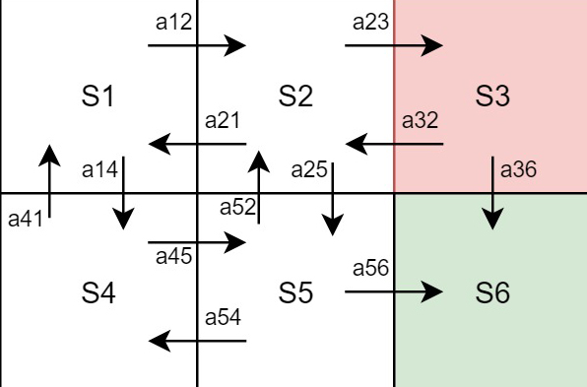
Q Learning Algorithm (Grid World)
Q(S, A) | Value
Q(S1, A12) | 0
Q(S1, A14) | 0
Q(S2, A21) | 0
Q(S2, A23) | 0
Q(S2, A25) | 0
Q(S3, A32) | 0
Q(S3, A36) | 0
Q(S4, A41) | 0
Q(S4, A45) | 0
Q(S5, A54) | 0
Q(S5, A52) | 0
Q(S5, A56) | 0
8- Update the q table with new Q(S2, A23) value = 0.
9- New State became S3.

Slide 69
Q Learning Algorithm (Grid World)
10. Observe the current state S3 (the red state), available actions are (a32, a36) lets say we took action a36 so we became at state S’ = S6.
11. Calculate q_new(S3, a36) with the equation using q-values from the table.
q_new(S3, a36) = r = 100, because there is no actions in S’ -> S6 (Goal)

Slide 70
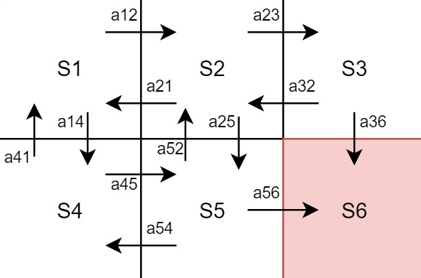
Q Learning Algorithm (Grid World)
Q(S, A) | Value
Q(S1, A12) | 0
Q(S1, A14) | 0
Q(S2, A21) | 0
Q(S2, A23) | 0
Q(S2, A25) | 0
Q(S3, A32) | 0
Q(S3, A36) | 100
Q(S4, A41) | 0
Q(S4, A45) | 0
Q(S5, A54) | 0
Q(S5, A52) | 0
Q(S5, A56) | 0
12- Update the q table with new Q(S3, A36) value = 100.
13- New State became S6 (Goal or Terminal State) and the episode ends.

Slide 71
Q Learning Algorithm (Grid World)
14. After Episode 1 ends, Start Episode 2 with Random State for example S2 (the red state), available actions are (a21, a23, a25) lets say we took action a23 so we became at state S’ = S3.
11. Calculate q_new(S2, a23) with the equation using q-values from the table.
q_new(S2, a23) = r + 0.5 * max[q(S3, a32), q(S3, a36)]
= 0 + 0.5 * 100 = 50

Slide 72
Q Learning Algorithm (Grid World)
Q(S, A) | Value
Q(S1, A12) | 0
Q(S1, A14) | 0
Q(S2, A21) | 0
Q(S2, A23) | 50
Q(S2, A25) | 0
Q(S3, A32) | 0
Q(S3, A36) | 100
Q(S4, A41) | 0
Q(S4, A45) | 0
Q(S5, A54) | 0
Q(S5, A52) | 0
Q(S5, A56) | 0
12- Update the q table with new Q(S2, A23) value = 50.
13- New State became S3, and So on for N episodes.

Slide 73
Q Learning Algorithm (Grid World)
Q(S, A) | Value
Q(S1, A12) | 25
Q(S1, A14) | 25
Q(S2, A21) | 12.5
Q(S2, A23) | 50
Q(S2, A25) | 25
Q(S3, A32) | 25
Q(S3, A36) | 100
Q(S4, A41) | 12.5
Q(S4, A45) | 50
Q(S5, A54) | 25
Q(S5, A52) | 25
Q(S5, A56) | 100
After a lot of episodes of updating the Q-Values Table,
Lets say after 200 episode we have these values on the left, so we finally know the policy to solve the grid world problem.
At State 1 choose Action A12 or A14 = 25.
At State 2 choose Action A23 = 50.
At State 3 choose Action A36 = 100.
At State 4 choose Action A45 = 50.
At State 5 choose Action A56 = 100.

Slide 74
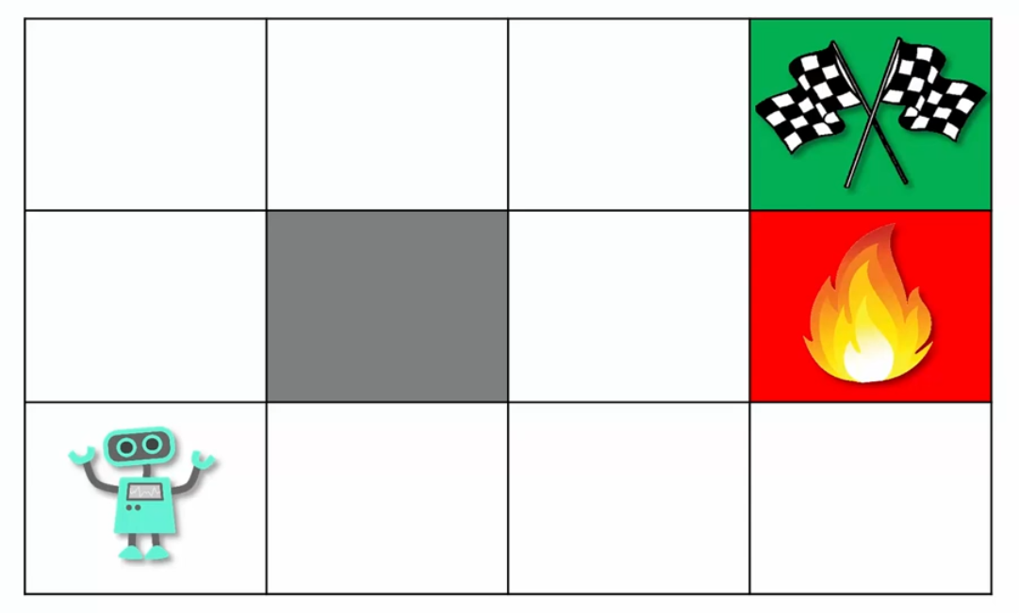
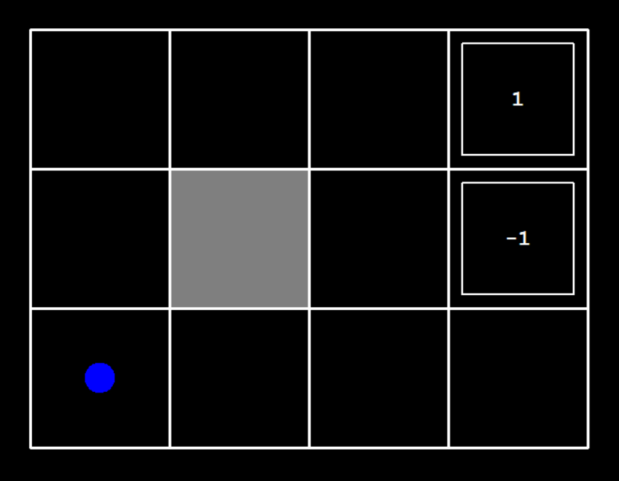
Q Learning Algorithm (Another Grid World)
Consider a grid world environment that a robot wants to reach the flag and stay away from fire.

Slide 75
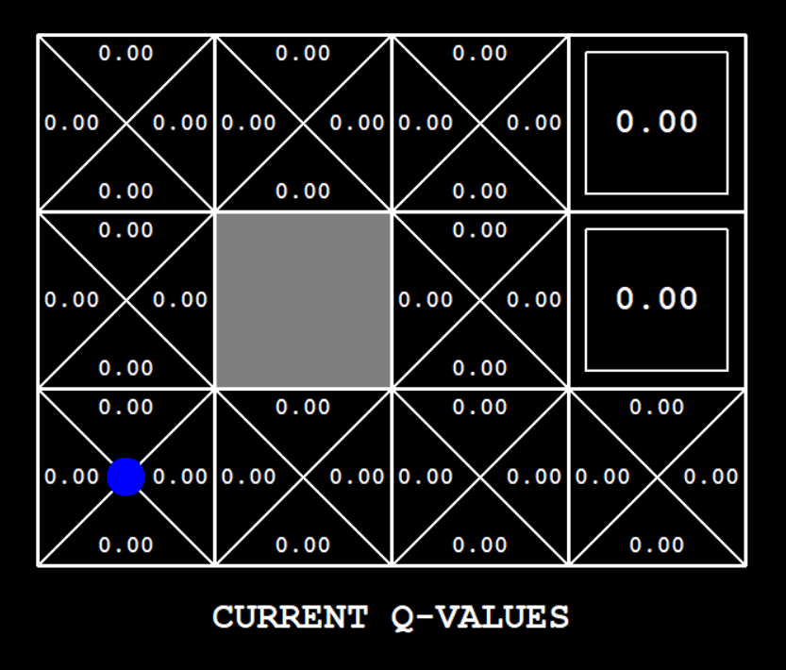
Q Learning Algorithm (Another Grid World)
1. Initialize Q(s, a) by setting all of the Q-Values for each state equal to zero, epsilon = 1, gamma = 0.9, alpha = 0.7, the flag reward is +1 & fire penalty is -1 and every step has penalty 0, number of episodes = 400.
2. Observe the current state (the blue circle).
3. Based on the epsilon-greedy policy, choose an action, At first epsilon = 1, so the agent will take random actions for the first episodes.
4. after a while the agent gains some knowledge so it should be greedy and exploit its knowledge, after a lot of episodes epsilon became very small thus a little explored random actions is taken.
5. After taking an action, observe the new state and the resulting reward.

Slide 76
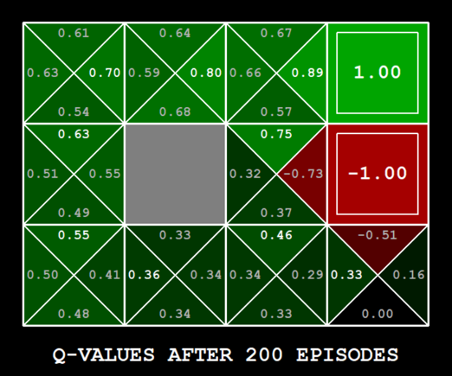
Q Learning Algorithm (Another Grid World)
6. The episode ends when the agent reaches the flag or the fire, lets say the agent is in state [0, 2] it choses action right then it reaches the flag and gains the reward 1, so it knows that the action (right) led to the flag, it’s a good action so updates the q-value of the action with the equation below
q_new([0, 2], Right) = (1-0.7) * 0 + 0.7 (1) = 0.7
7. At a next step we ended for example at state [0, 1] and took action right, then the new q is
q_new([0, 1], Right) = (1-0.7) * 0 + 0.7 (0 + 0.9 * 0.7) = 0.441
8. Repeat the steps for many episodes, and keep updating Q-values, after many episodes it will be like the image.

Slide 77
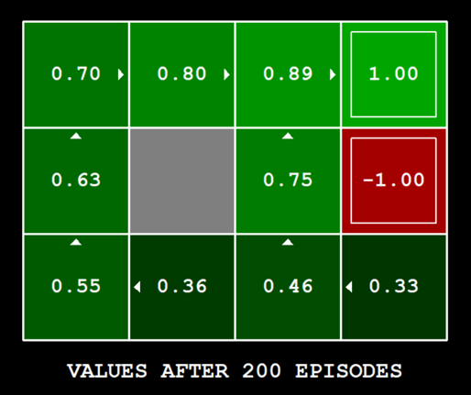
Q Learning Algorithm (Another Grid World)
So at the end we will have the optimal policy that can plays the game with its own to have the maximum reward.

Slide 78
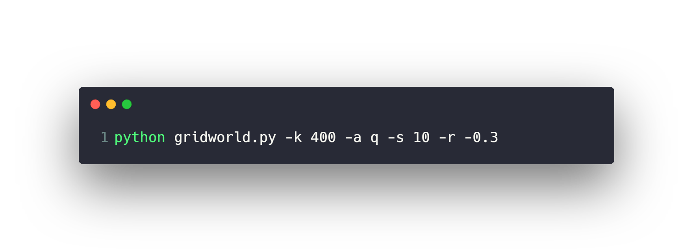
Q Learning Algorithm (Another Grid World)
To run the code.

Slide 79

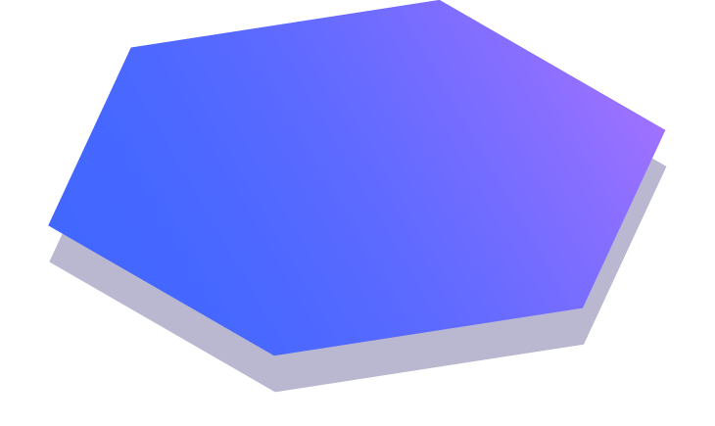
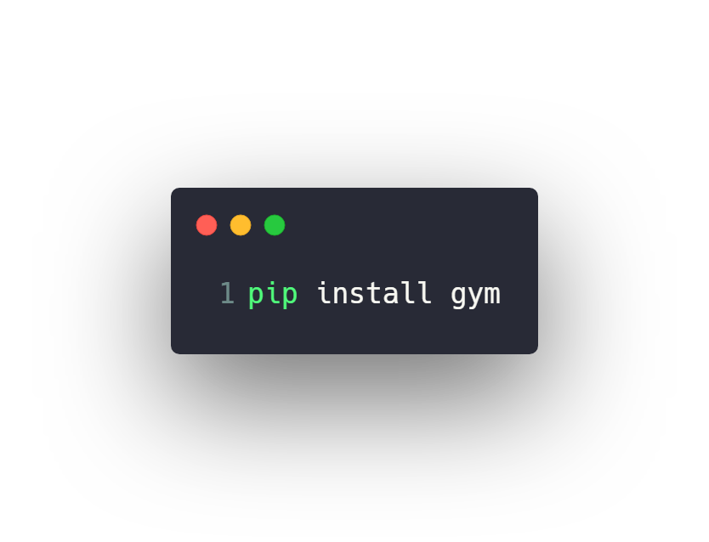
Open AI Gym
Gym is a toolkit for developing and comparing reinforcement learning algorithms. It supports teaching agents everything from walking to playing games like Pong or Pinball.
https://gym.openai.com/

Slide 80
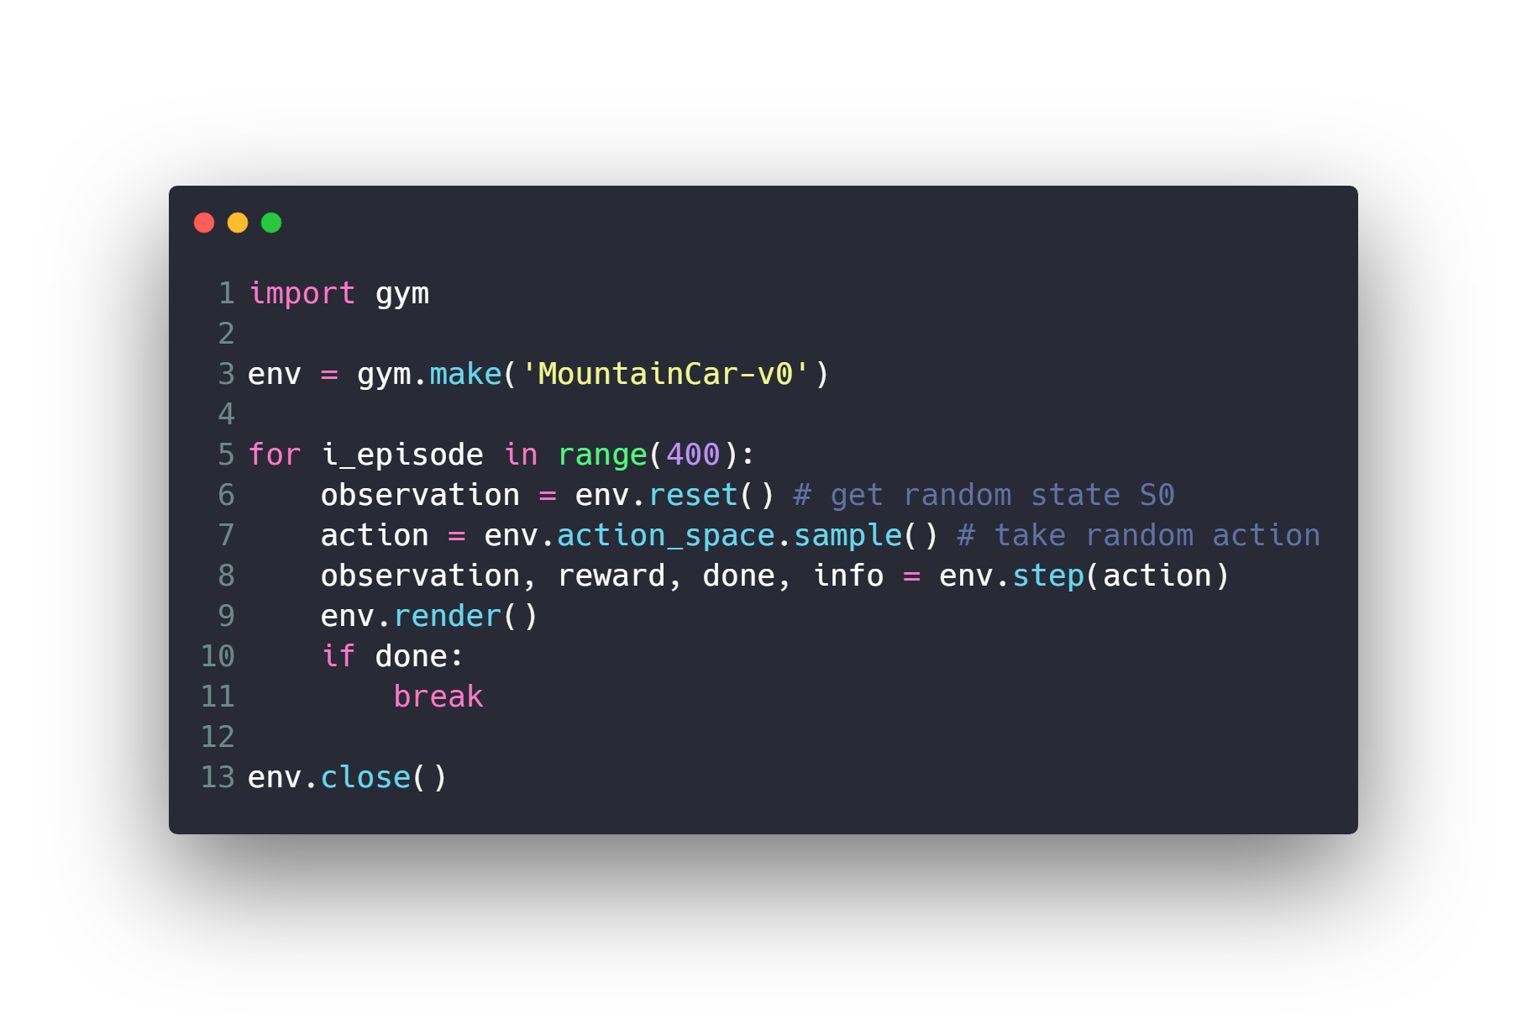
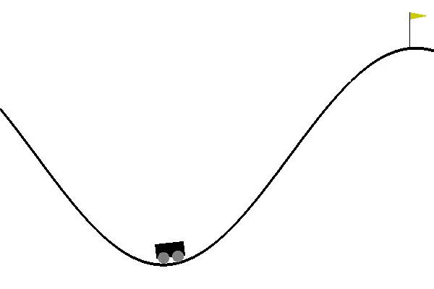
Open AI Gym – Mountain Car

Slide 81
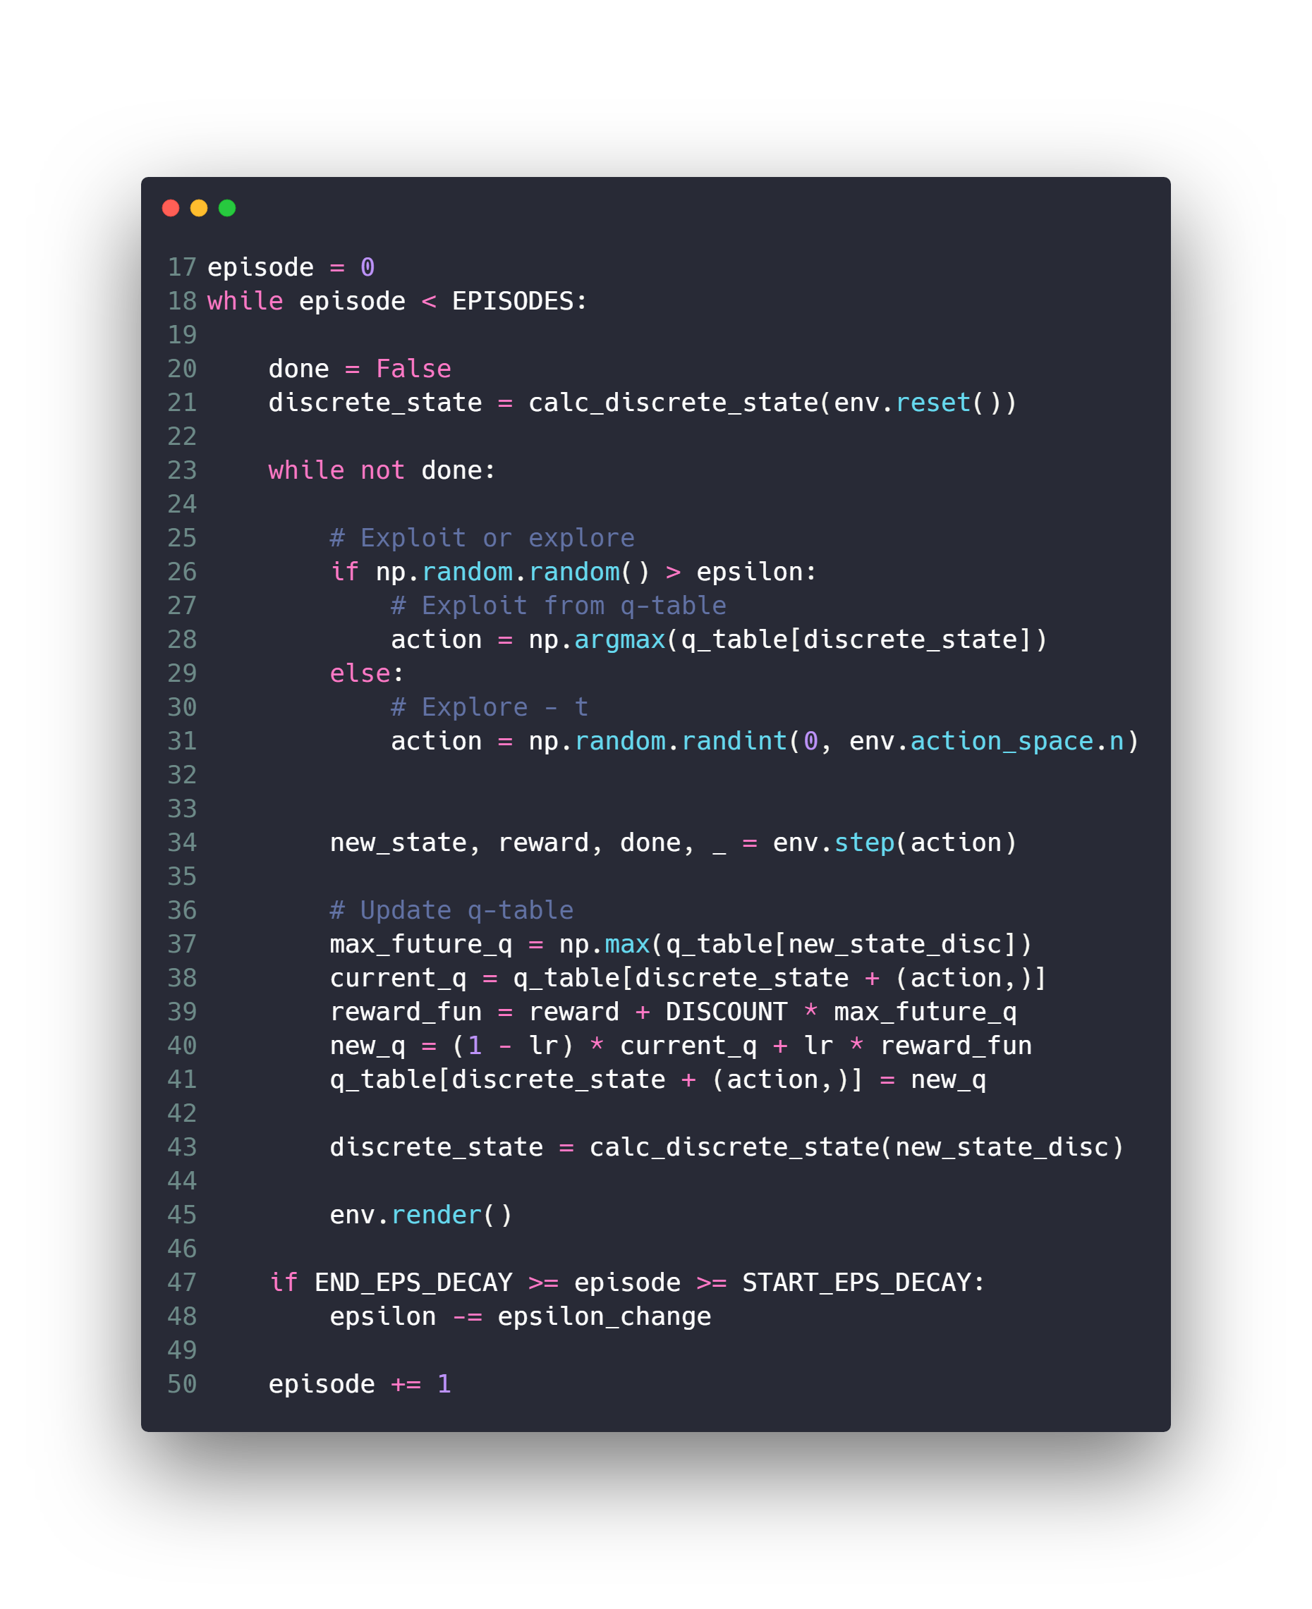
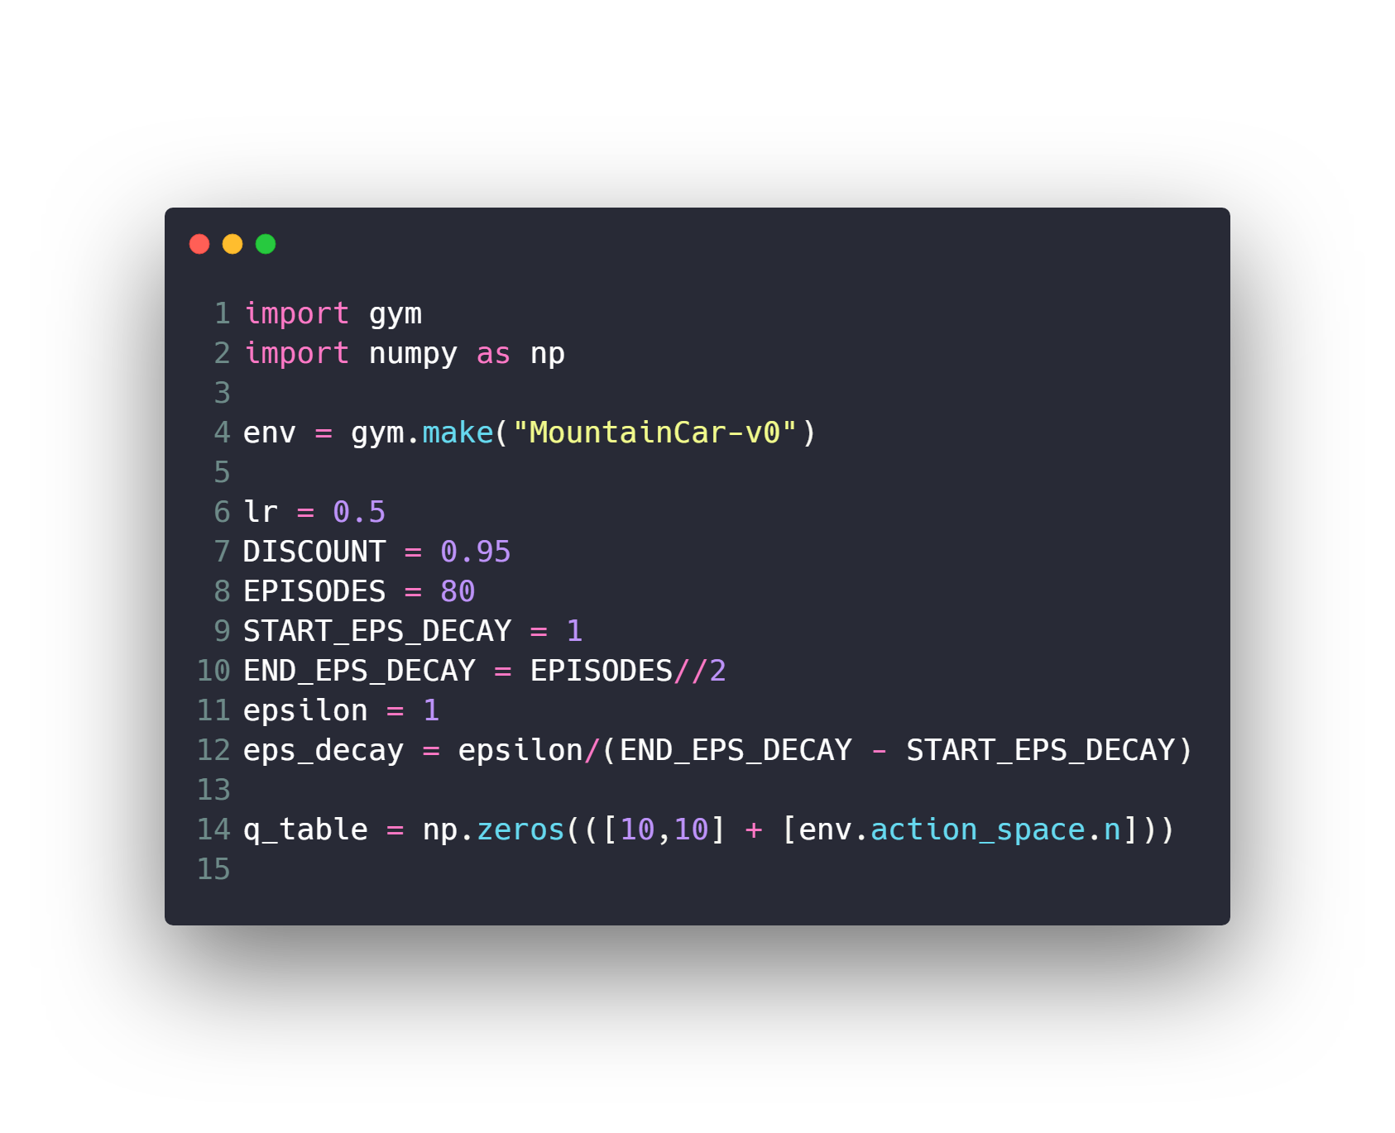

Slide 82
Questions ?!

Slide 83
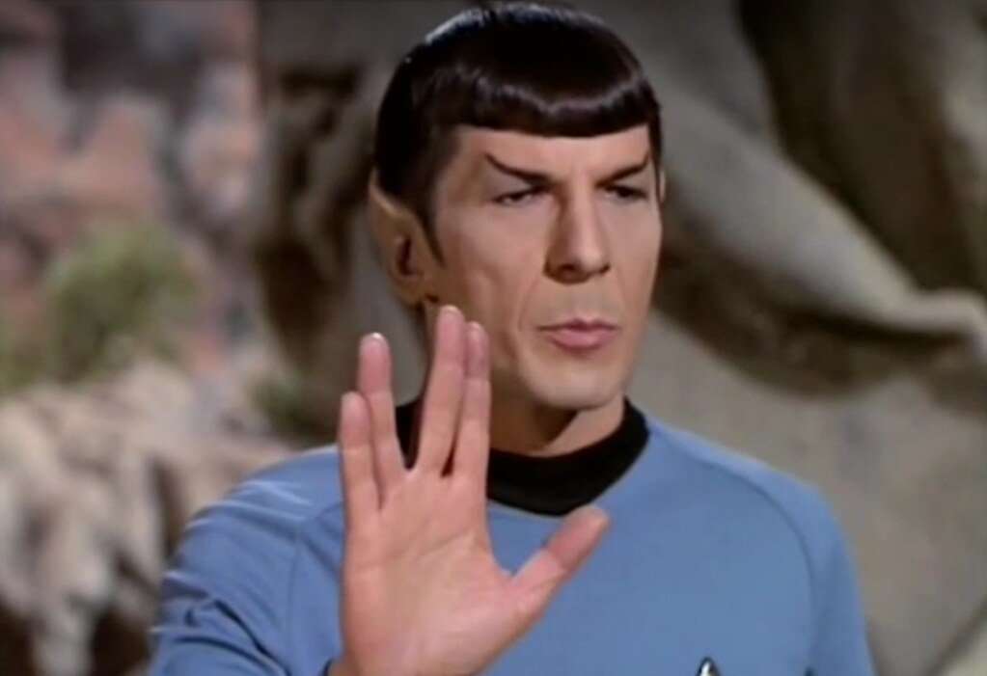
Thanks! >_ Live long and prosper

